Slide 1
Nutrition
IGCSE Biology

Slide 2
Question list part I - Diet
1. What are the 7 types of nutrients animals need from their diet?
2. What kind of diet is a balanced diet?
3. What food is rich in carbs, proteins, fats, fibre, Vitamin C, Vitamin D, calcium and iron, respectively?
4. Give examples of two groups of people that need more energy than others.
5. a) What would deficiency disease/ symptoms of Vitamin C be? Why?
b) What would deficiency disease/ symptoms of Vitamin D be? Why?
c) What would deficiency disease/ symptoms of calcium be? Why?
d) What would deficiency disease/ symptoms of iron be? Why?
6. What does obesity mean? What diseases are linked with obesity (name 2)?
7. How does excess fat intake results in heart disease?
8. What is malnutrition?
9. a) What causes kwashiorkor?
b) Please list several symptoms of kwashiorkor
c) Usually at which age of people will kwashiorkor affect most?
d) How can kwashiorkor be treated?
10. a) What causes marasmus?
b) What similarity do kwashiorkor and marasmus share?

Slide 3
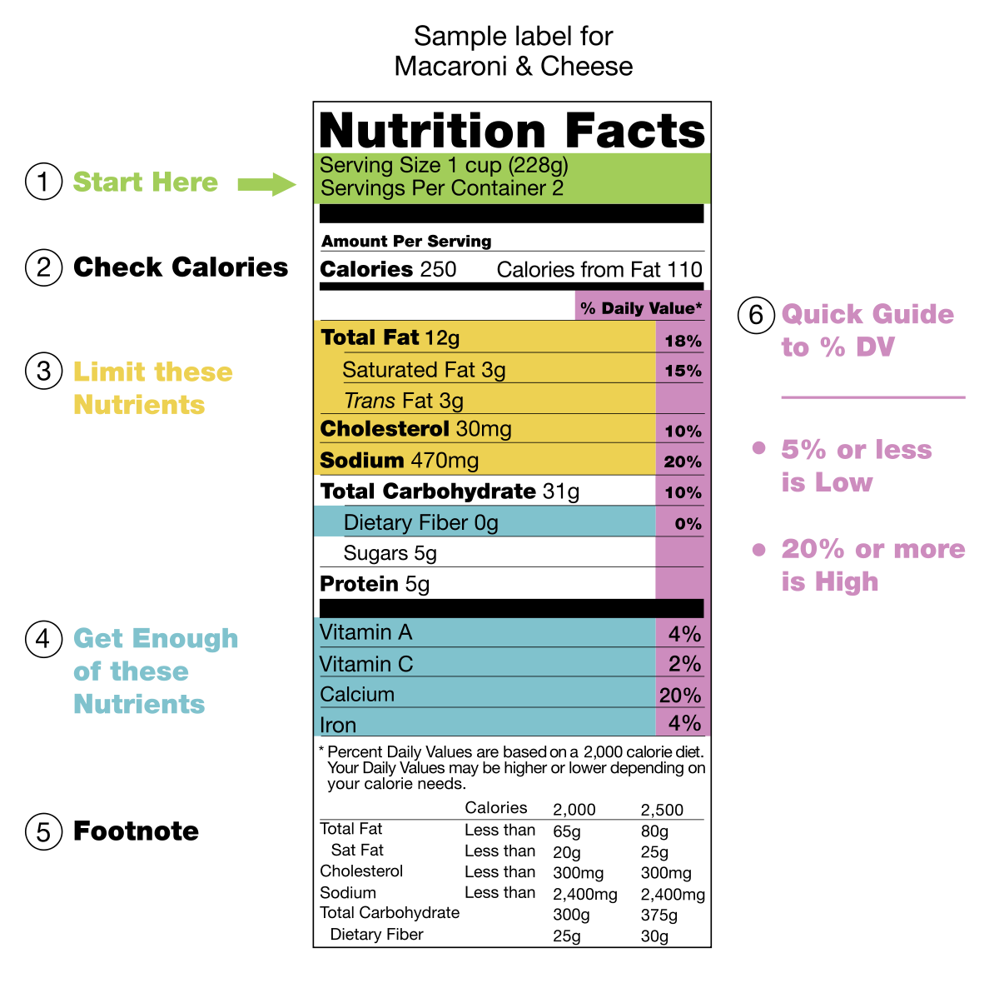

Slide 4
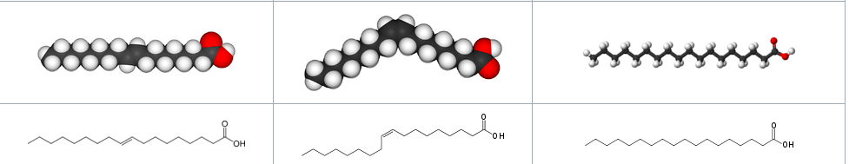

Saturated fat V.S. Unsaturated fat
A saturated fat is a type of fat in which the fatty acid chains have no double bonds between Carbon atoms (no -C=C-) (all single bonds).
They are called saturated, because all C are saturated with hydrogen atoms.
Saturated fats tend to be solids at room temperatures, while unsaturated fats tend to be liquid at room temperature (saturated fats have higher melting point).
Most animal fats are saturated. The fats of plants and fish are generally unsaturated.
Trans-unsaturated fat
Cis-unsaturated fat
Saturated fat

Slide 5
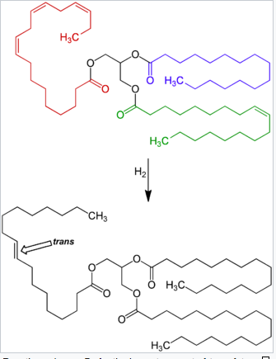
Saturated fat V.S. Unsaturated fat
Double bonds can react with hydrogen to form single bonds, so unsaturated fat can be hydrogenated to become saturated fat.

Slide 6
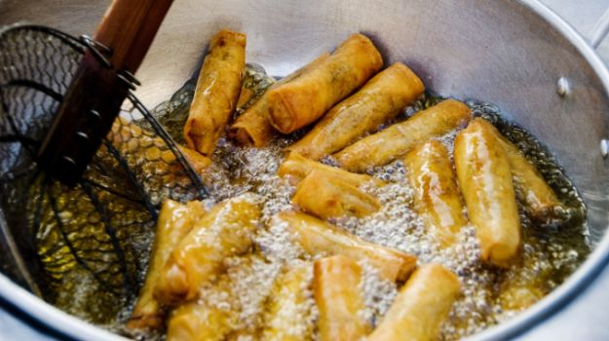


Trans fat
Trans fat, also called trans-unsaturated fatty acids or trans fatty acids, is a type of unsaturated fat.
It became widely produced industrially from vegetable and fish oils in the early 20th century for use in margarine and later also in snack food, packaged baked goods, and for frying fast food.
Trans fat has different chemical and physical properties, such as giving food desirable taste & texture and longer shelf life.
E.g. The trans fatty acid elaidic acid has a much higher melting point, 45 ℃, than oleic acid, 13.4 ℃.
Although trans fats are edible, consuming trans fats has been shown to increase the risk of heart disease.
反式脂肪在食物成分表中可能没有标识，但在配料表中，部分氢化大豆油、部分氢化棕榈油、植脂末、精炼植物油、起酥油、酥油、人造奶油都是反式脂肪的代名词。

Slide 7

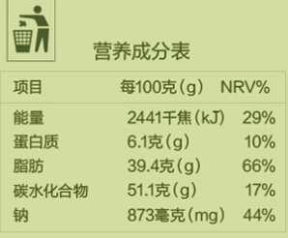
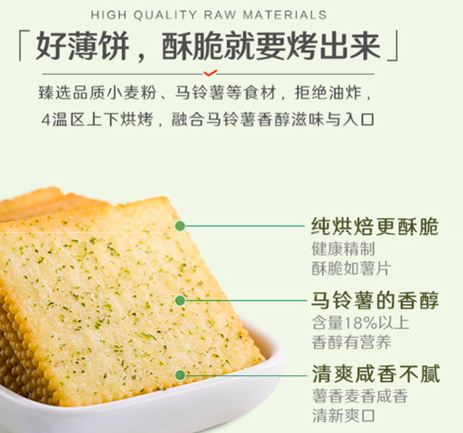
Example 1

Slide 8


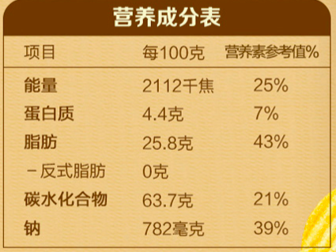
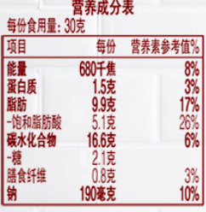
Example 2

Slide 9


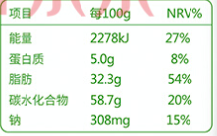
Example 3

Slide 10

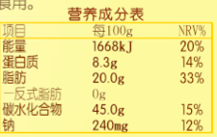
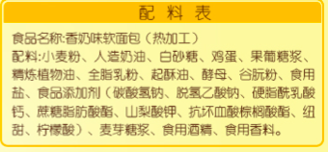
Example 4

Slide 11
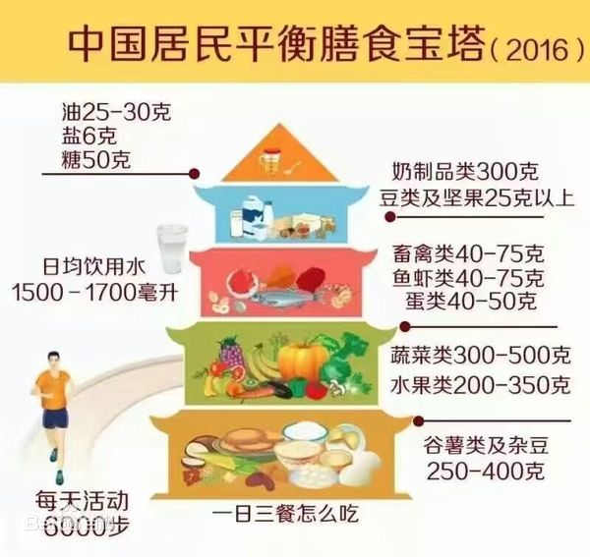
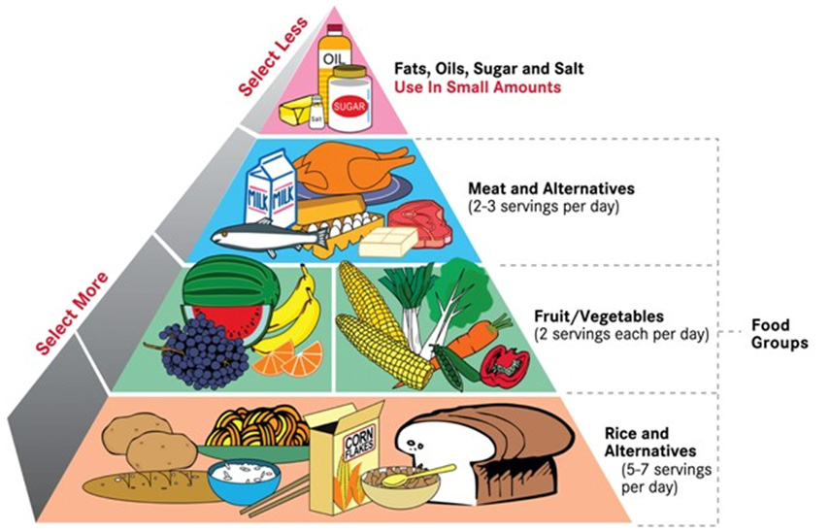
Balanced diet

Slide 12
Nutrients
https://www.britannica.com/science/lipid
Nutrient type | Chemical elements they contain | Basic units/ smaller molecules that make up them | Some example molecules of this category | Functions
Carbohydrates | Carbon Hydrogen Oxygen | Monosaccharides (e.g. Glucose Fructose). | Glycogen Starch Cellulose | Provide energy
fat & oil (triglyceride) | Carbon Hydrogen Oxygen | Fatty acids Glycerol | N/A (specific molecules not required here) | Good stores of energy
Proteins | Carbon Hydrogen Oxygen Nitrogen (and Sulphur) | Amino acids | Enzymes Haemoglobin Antibodies | Used for growth and tissue repair
Notes:
Lipid contain various types of molecules, including fatty acids (& their derivatives like fat, oil), waxes, cholesterol, phospholipid (Glycerophospholipids), Vitamin A,D,E,K, steroid hormone, etc. (nonglyceride lipids such as phospholipids, sterols, vitamins A, D, and E)

Slide 13
Nutrient groups
Nutrient | Main sources | Importance in the diet
Carbohydrates | Rice, bread, noodles, pasta, potatoes, cereals, corn | Provide energy
Fats | Butter, oils, egg | Energy stores, insulation
Proteins | Meat, fish, peas and beans, tofu, milk, nuts | Growth and tissue repair
Vitamins (C and D) | Citrus fruits, green vegetables | Healthy tissues
 | Milk, cheese | Strong bones and teeth
Minerals (calcium and iron) | Milk, cheese, diary products | Strong bones and teeth
 | Liver, red meat | Used to make haemoglobin
Fibre (roughage) | Cereals, wholemeal bread, vegetables | Prevents constipation
Water | Drinks, fruit | Prevents dehydration, solvent.

Slide 14
Deficiency diseases
Nutrient | Found in | Needed for | Prevents | Symptoms of disease
Vitamin C | Oranges, lemons (citrus fruits) | collagen, Tissue repair | Scurvy | Bleeding gums; pain in joints and muscles
Vitamin D | milk, butter, egg yolk (and can be made by skin when in sunlight | help to absorb Ca, Strong teeth and bones | Rickets (especially affect children) | Soft & deformed bones
Iron | Liver, red meat, dark green vegetables, egg yolk. | Making haemoglobin in red blood cells | Anaemia | Tiredness/ fatigue, paleness, dizziness, shortness of breath
Calcium | milk and other dairy products, bread | Strong teeth and bones. Blood clotting. | Osteoporosis | Brittle bones and teeth. Poor blood clotting.

Slide 15
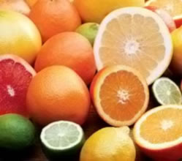
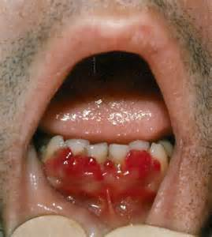
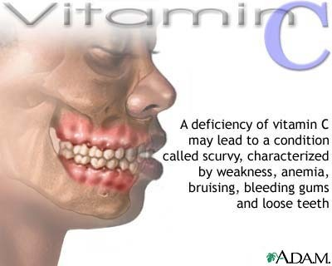
Scurvy

Slide 16
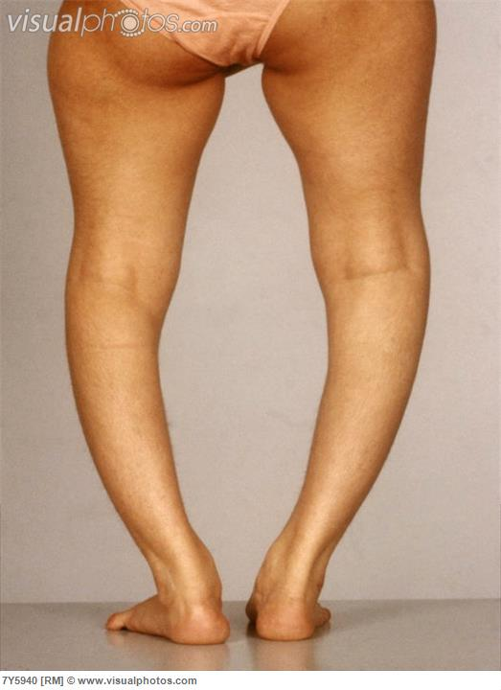
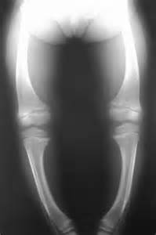
Rickets

Slide 17
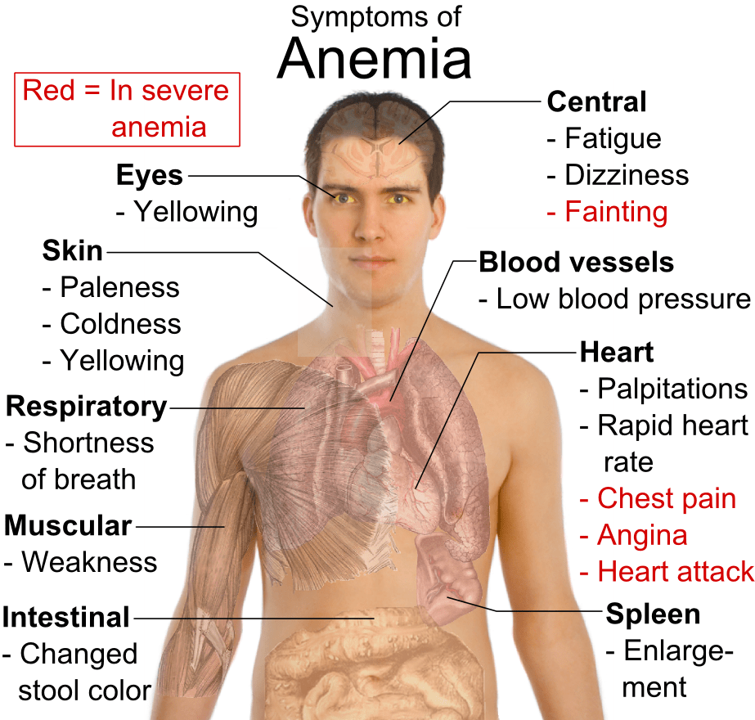
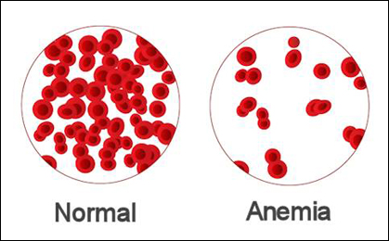
Anaemia

Slide 18
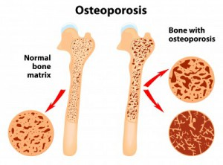
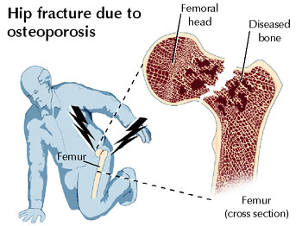
Osteoporosis (Ca deficiency)

Slide 19
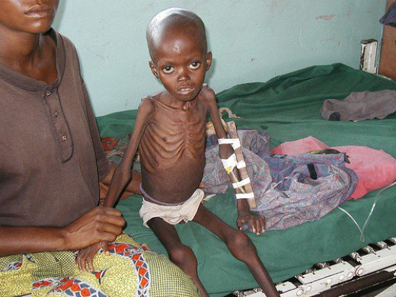
Protein-energy malnutrition
kwashiorkor
marasmus

Slide 20
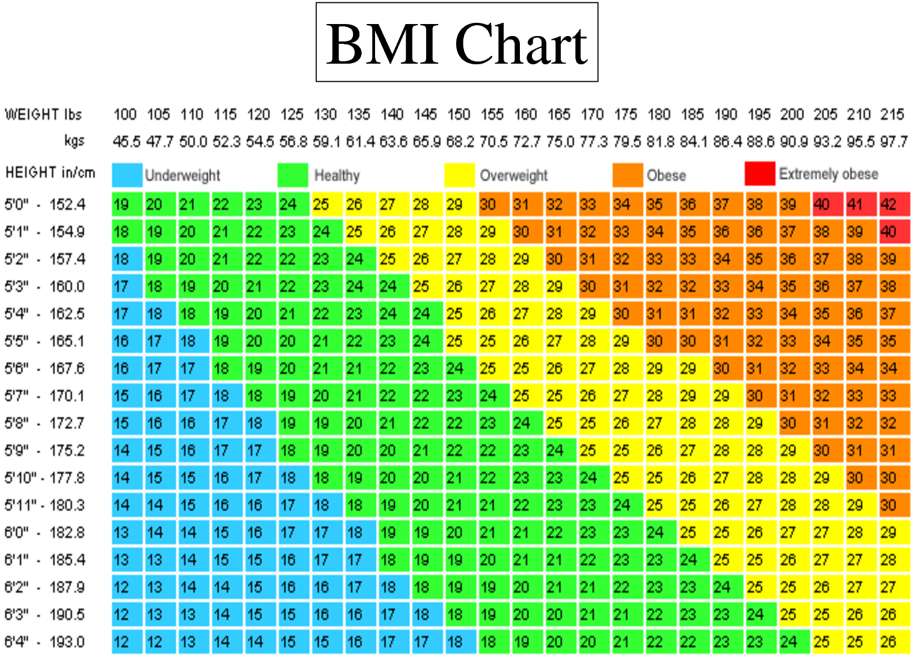
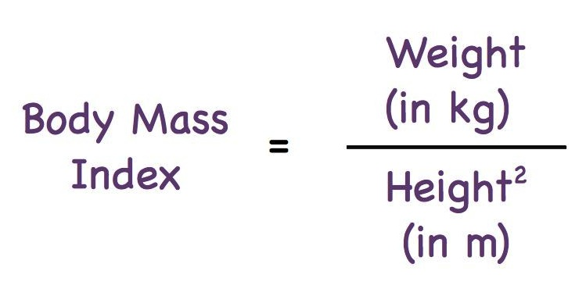
Obesity

Slide 21
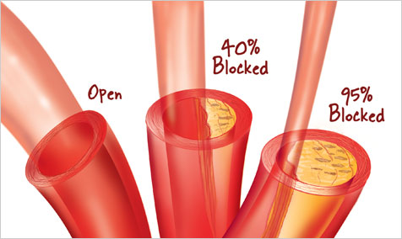
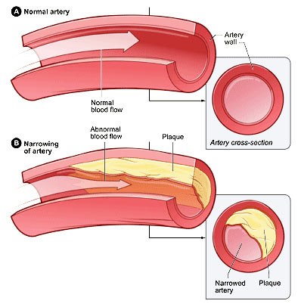
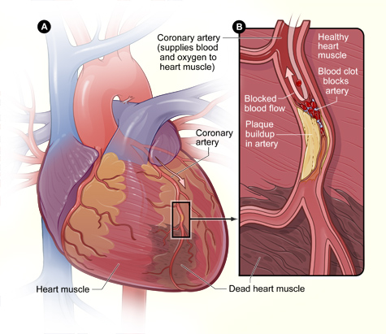
Coronary Heart Disease
How do too much fat in diet link to CHD? (explain step by step)

